Slide 1
Lecture 6
Logistic Regression

Slide 2
Introduction
So far we discussed how regression can be used to adjust some model to data in order to make quantitative predictions
A similar problem is to adjust a model to data but instead of making quantitative predictions you want to predict a Boolean value (TRUE/FALSE)
Typical example: is the email spam or not spam?
Notes:
So far we discussed how regression can be used to adjust some model to data in order to make quantitative predictions
For example we studied how a model can be used to represent the power generation of a windmill based on some historical data. Such models can then be used to try to predict future power generation of this windmill.
Now, a similar problem is, instead of making quantitative predictions, you want to predict a Boolean value. So a TRUE/FALSE value.
A typical example is a spam filter. You want o predict if a given email spam or not a spam.
To predict Boolean values rather than numerical values is the topic of this lecture

Slide 3











Estimating if an instance belongs to a class
Example: handwritten digit recognition
Data set:
The labels will be either equal to 1 or 0 (1: picture represents a certain digit, e.g. the digit 4; 0: picture does not represent the given digit)
$$⋯$$
$${\underline{x}}^{(1)}$$
$${\underline{x}}^{(2)}$$
$${\underline{x}}^{(3)}$$
$$⋯$$
$${\underline{x}}^{(m)}$$
$$y^{(1)}$$
$$y^{(2)}$$
$$y^{(3)}$$
$$⋯$$
$$y^{(m)}$$
Notes:
In machine learning, fitting data set containing Boolean values belong to the more general classification problem.
In classification one wants to predict of a given instance belongs or does not belong to a given class.
In the case of a spam filter that would be to classify an email either as a spam or a legitimate email
Another example is recognition of hand-written digits
There the data set is a collection of pictures of hand written digits
Some of these pictures will represent the digit 4 other will not.
So one would say the label y(i) associated to picture number i is true if the picture represents the digit 4 or it would be false if the digit does not represent the digit 4
Often the labels will simply store the numbers 1 and 0 instead of TRUE and FALSE

Slide 4
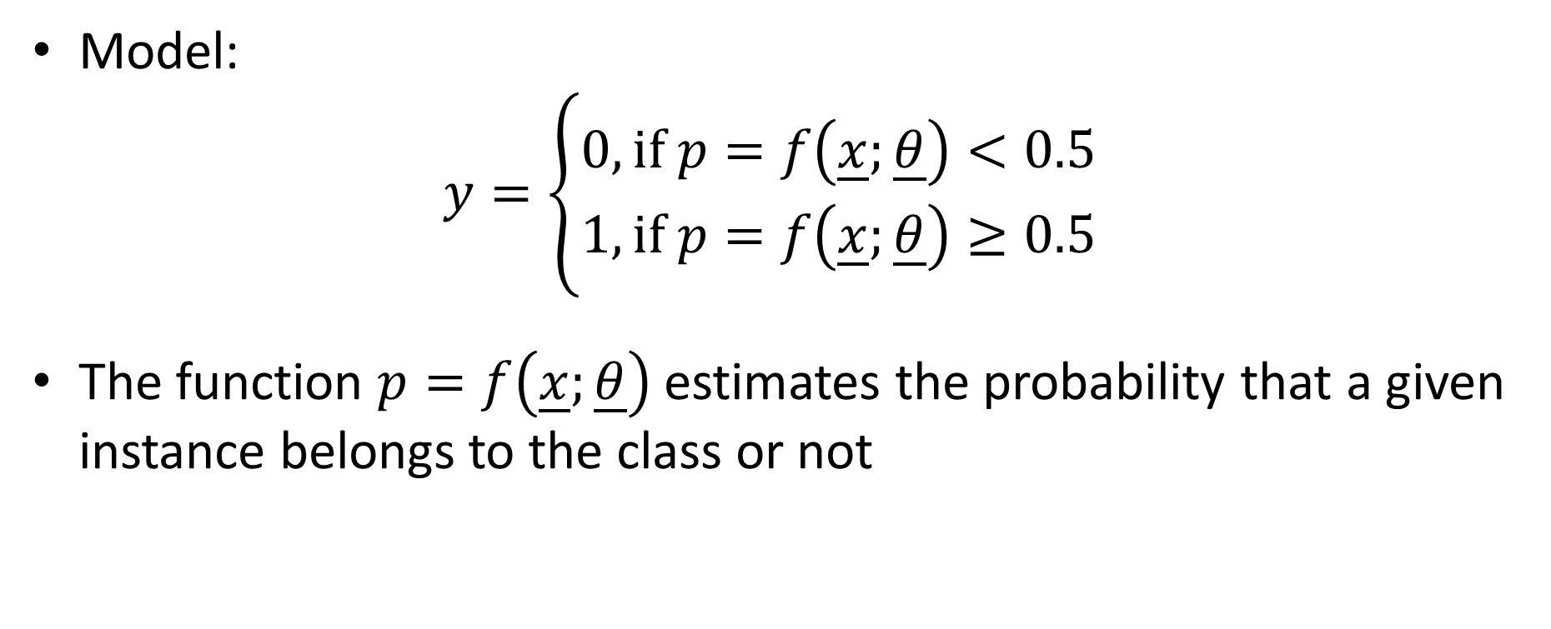
Estimating if an instance belongs to a class
Model:
$$y=\left\{\begin{aligned}0,\text{if} p=f\left(\underline{x};\underline{θ}\right)<0.5 \\ &1,\text{if} p=f\left(\underline{x};\underline{θ}\right)≥0.5\end{aligned}\right.$$
The function $p=f\left(\underline{x};\underline{θ}\right)$ estimates the probability that a given instance belongs to the class or not
Notes:
Having in mind these examples, how would we model such a situation?
Our mathematical model will not predict a number, but rather TRUE of FALSE depending if the instance belongs or does not belong to the class of interest
Mathematical functions giving just TRUE or FLASE as output may be a little tricky to handle for various reasons.
In fact, intuitively you know as well that the situation is not really black or white. For example, if you look to a image of a hand written digit you may rather say : yes it is very likely that this image is representing the digit 4. For a not so well hand-written digit the situation may not be that clear. Is it really a 4? Or maybe a one?
So it is certainly better to try to associate a probability to a given instance and then, based on this probability decide if the instance belongs to the class or not
And this is exactly what logistic regression does
We model mathematically the probability to belong to a class or not.
This model $p=f\left(\underline{x};\underline{θ}\right)$, which estimates the probability, will have some parameters that need to be adjusted based on a data set
If the function f will output a probability smaller than 0.5, we will say the instance does not belong to the class. Consequently y should be equal to FALSE or 0
If f will output a value larger than 0.5, then we say the instance belongs to the class and y is equal to TRUE or 1

Slide 5
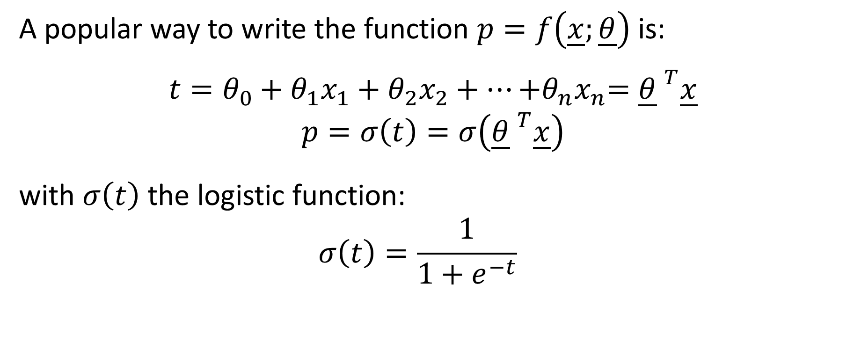
Logistic function
A popular way to write the function $p=f\left(\underline{x};\underline{θ}\right)$ is:
$$t=θ_{0}+{θ_{1}x}_{1}+{θ_{2}x}_{2}+…{+θ_{n}x}_{n}={\underline{θ} }^{T}\underline{x}$$
$$p=σ\left(t\right)=σ\left({\underline{θ} }^{T}\underline{x}\right)$$
with $σ\left(t\right)$ the logistic function:
$$σ\left(t\right)=\frac{1}{1+e^{−t}}$$
Notes:
The function $p=f\left(\underline{x};\underline{θ}\right)$ is usually written in two steps
First one defines a variable t as a linear combination of features and feature weights which means $t=θ_{0}+{θ_{1}x}_{1}+{θ_{2}x}_{2}+…{+θ_{n}x}_{n}$
Then based on t on computes the probability p using a function sigma
This function sigma is derived based on statistical considerations
We will not give here the derivation of this function but simply show how to use it and that it actually makes sense. For the one interested let us mention that this function sigma is realted to the binomial distribution.
The function sigma is the logistic function defined as $σ\left(t\right)=\frac{1}{1+e^{−t}}$

Slide 6


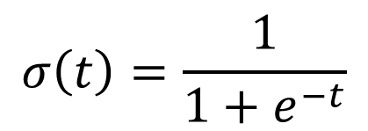
Logistic function
$$p=σ(t)$$
$$σ\left(t\right)=\frac{1}{1+e^{−t}}$$
$$t$$
Notes:
It is interesting to plot the logistic function
For high values of t, the function goes towards one
For very negative values of t, the function tends towards 0
For t=0 we have sigma=0.5
This particular shape, similar to the tilted letter S, gives the name to the logistic function: the Greek letter sigma which is the Greek version of the letter S.
Sometimes the logistic function is as well called sigmoid function.
How can we interpret this function?
The plot demonstrates that high values of t are associated to high probabilities whereas very negative values of t are associated to probabilities nearly equal to zero
The idea of logistic regression will be to compute out of the features the value t such that if the instance belongs to the class then we obtain a high value of t. Whereas if the instance does not belong to the class, then the value t will be very negative.
Logistic regression will do this by adjusting accordingly the model parameters theta used to compute the variable t

Slide 7
Logistic regression
The aim of logistic regression is to adjust the logistic function to the data set
For this one needs a cost function that will be minimized in the training phase
Notes:
We already understand that the aim of logistic regression is to adjust the logistic function to a data set. In fact it isn’t so much the logistic function which is adjusted but rather the intermediate variable t.
But in any case we need a cost function that will be minimized in the training phase

Slide 8
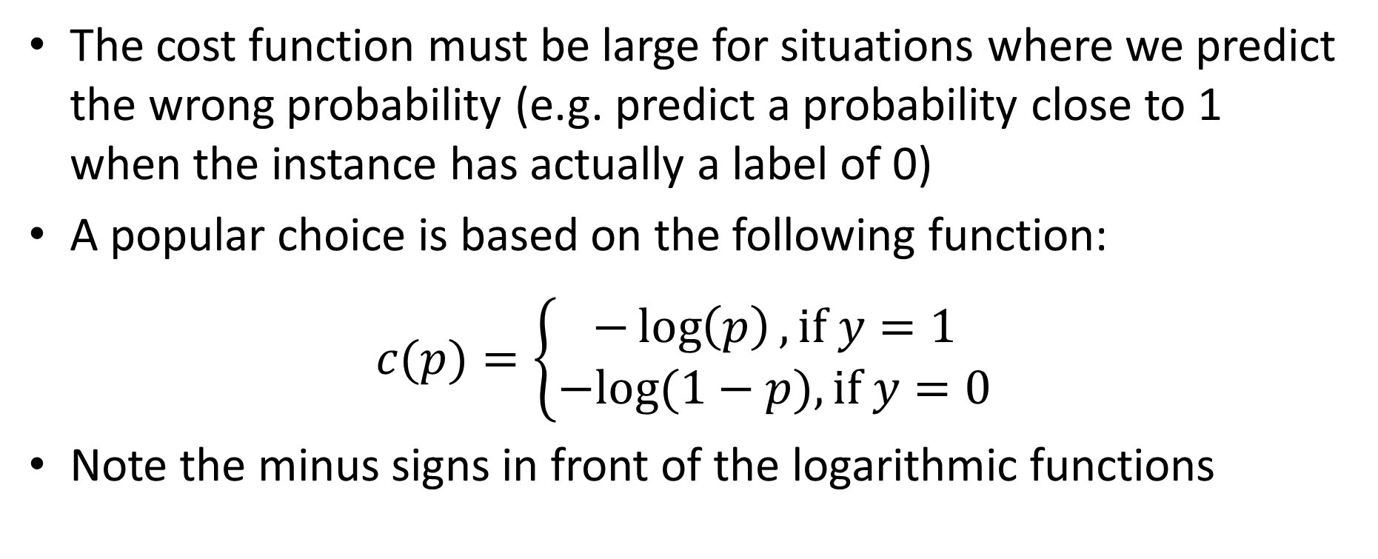
Cost function
The cost function must be large for situations where we predict the wrong probability (e.g. predict a probability close to 1 when the instance has actually a label of 0)
A popular choice is based on the following function:
$$c(p)=\left\{\begin{aligned}−\log\left(p\right),\text{if} y=1 \\ &−log⁡(1−p),\text{if} y=0\end{aligned}\right.$$
Note the minus signs in front of the logarithmic functions
Notes:
Now this cost function must satisfy a major properties:
The cost function must be large for situations where we predict the wrong probability
For example if the instance is labeled as 0, the cost function must be very large if the model trys to predict a high probability
Using various methods from statistics it is possible to derive such cost functions. We wont derive them here but, as for the logistic function, just show how to use them and explain why this cost function makes sense
An example of such cost function is based on the function c(p) defined as displayed on the slide
Note the minus sign in front of the logarithmic functions
C(p) is defined partwise depending on how the instance is labeled
If y=1, which means that the instance belongs to the class (for example the email is a spam) then c(p) is defined as –log(p)
If on the contrary y=0, which means that the instance does not belongs to the class (for example the email is not a spam) then c(p) is defined as –log(1-p)

Slide 9



Cost function
Let us check if this cost function is sound
Case 1: $y=1$
We want that situations with low probability are costly and situations with high probability are not costly
$$c\left(p\right)=−log⁡(p)$$
High cost
Low cost
$$p$$
Notes:
Let us check if this cost function is sound
We consider first the case where the label of the instance is equal to one.
This is means the instance belongs to the class of interest
Here c(p) is defined as –log(p)
If we plot this function, we realize that the function has high cost for low probabilities but has low costs for probabilities close to one
That is indeed what we want. As y=1, we want to make costly wrong predictions which are in this case probabilities close to zero. On the other side we want to favor correct predictions which in this case are probabilities close to one.

Slide 10



Cost function
Case 2: $y=0$
We want that situations with low probability are not costly and situations with high probability are costly
$$c\left(p\right)=−log⁡(1−p)$$
High cost
Low cost
$$p$$
Notes:
Let us as well check the other case where y=0
This is means the instance does not belong to the class of interest
Here c(p) is defined as –log(1-p)
If we plot this function, we realize that the function has high cost for probabilities close to one but has low costs for probabilities close to zero
That is indeed what we want. As y=0, we want to make costly wrong predictions which are in this case probabilities close to one. On the other side we want to favor correct predictions which in this case are probabilities close to zero.

Slide 11
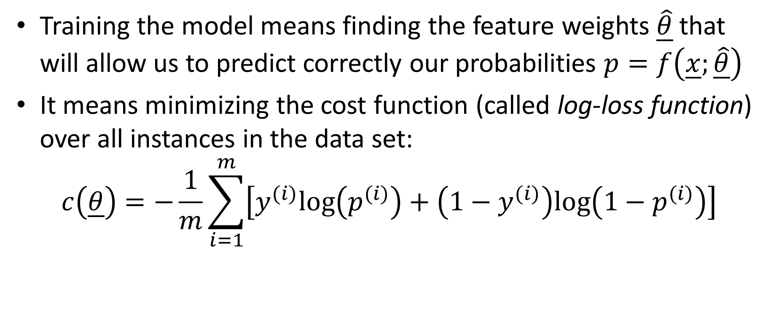
Cost function
Training the model means finding the feature weights $\underline{\hat{θ}}$ that will allow us to predict correctly our probabilities $p=f\left(\underline{x};\underline{\hat{θ}}\right)$
It means minimizing the cost function (called log-loss function) over all instances in the data set:
$$c\left(\underline{θ}\right)=−\frac{1}{m}\sum_{i=1}^{m}{\left[y^{(i)}\text{log}\left(p^{(i)}\right)+\left(1−y^{(i)}\right)\text{log}\left({1−p}^{(i)}\right)\right]}$$
Notes:
Training the model means finding the feature weights $\underline{\hat{θ}}$ that will allow us to predict correctly our probabilities $p=f\left(\underline{x};\underline{\hat{θ}}\right)$
This is achieved by minimizing the log-loss function. This cost function is defined as displayed on the slide
You will recognize our function c(p) we discussed in the previous slides
The log-loss function is defined as the sum over all functions c(p) evaluated in all instances.
Remember that the probabilities are calculated using the logistic function for each instance number i.

Slide 12


Probability of passing a course versus mid-term result
Data set ($m=91$)
Midterm grade $x^{(i)}$ | 54 | 71 | 14 | 83 | $$⋯$$ | 69
Pass / Fail $y^{(i)}$ | $$1$$ | 1 | 0 | 1 | $$⋯$$ | 1
Pass
Problem formulation:
Features: ${\underline{x}}^{(i)}=\left[\begin{matrix}1 \\ x^{(i)}\end{matrix}\right]$
Labels: $y^{(i)}=\left\{\begin{aligned}0, \text{FAIL} \\ &1, \text{PASS}\end{aligned}\right.$
Fail
Midterm grade
Notes:
Let us show with an example how logistic regression is applied
For this we use a data set containing midterm grades of a past semester of this course
In this example there were 91 students in the course
The x values are the grades, out of 100, the students got in the midterm
The labels are either 1 if the student did pass the course or zero if the student did fail the course
We can display this data set on a plot showing if the student passed or not the class in function of the midterm grade.
Not surprisingly one can observe that the higher the midterm grade, the more likely the student was to pass the course
If we formulate this problem in our machine learning notations we define the features as the column vectors [1 x(i)], where x(i) is the midterm grade of student number i.
The labels are either 0, if the student did at the end fail the class or 1 if he passed the class

Slide 13
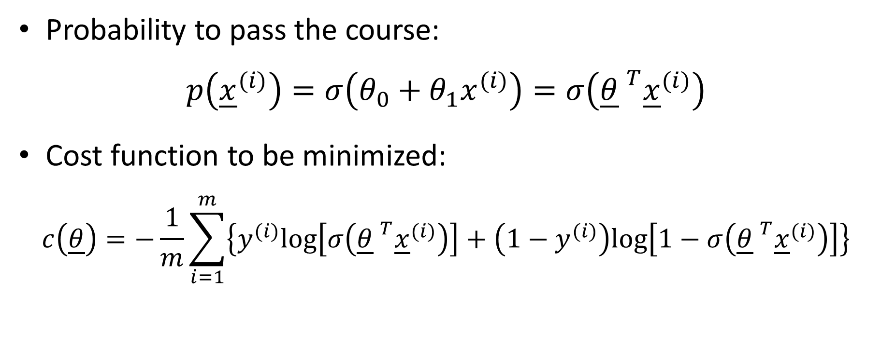
Problem formulation
Probability to pass the course:
$$p\left({\underline{x}}^{(i)}\right)=σ\left(θ_{0}+θ_{1}x^{(i)}\right)=σ\left({\underline{θ} }^{T}{\underline{x}}^{(i)}\right)$$
Cost function to be minimized:
$$c\left(\underline{θ}\right)=−\frac{1}{m}\sum_{i=1}^{m}{\left\{y^{(i)}\text{log}\left[σ\left({\underline{θ} }^{T}{\underline{x}}^{(i)}\right)\right]+\left(1−y^{(i)}\right)\text{log}\left[1−σ\left({\underline{θ} }^{T}{\underline{x}}^{(i)}\right)\right]\right\}}$$
Notes:
The probability to pass the course is computed according the function $p\left({\underline{x}}^{(i)}\right)$
The variable t is computed as t=$θ_{0}+θ_{1}x^{(i)}$
Putting all together gives us $p\left({\underline{x}}^{(i)}\right)=σ\left(θ_{0}+θ_{1}x^{(i)}\right)$ or in vector notations $σ\left({\underline{θ} }^{T}{\underline{x}}^{(i)}\right)$
The cost function to be minimized can be written down too as displayed on the slide
You may wish to take some time to read these expressions carefully and understand them

Slide 14
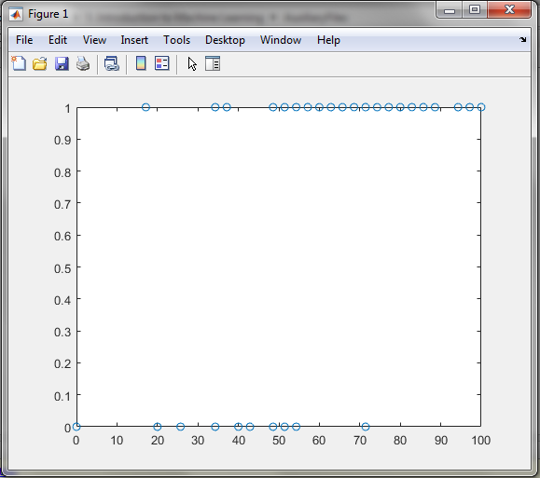
Solving with Matlab
Step 1: enter the data set
>> x=[54; 71; 14; 83; …]
>> y=[1; 1; 0; 1; ….]
>> plot(x, y, ’o’);
Notes:
Logistic regression possible to do with simple algorithms. But as for regression with regularization matlab implements a function to perform logistic regression
We will show in our example how to use this matlab function
At first we need to enter the data set
We do this by defining a column vector x containing all midterm grades
We define as well a column vector y containing the labels.
To check if we entered correctly our data set we can plot it

Slide 15
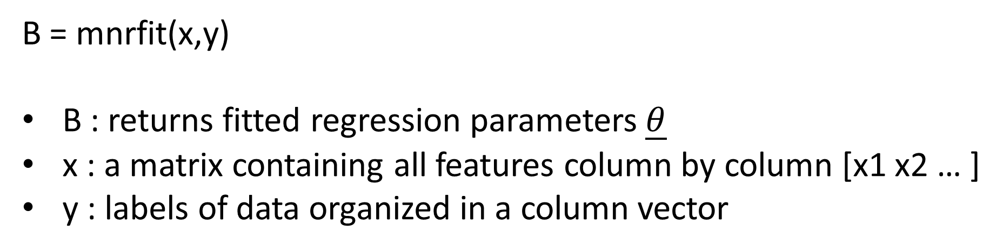
Logistic regression in Matlab
Matlab provides a function implementing logistic regression:
We present this function in the following format:
B = mnrfit(x,y)
B : returns fitted regression parameters $\underline{θ}$
x : a matrix containing all features column by column [x1 x2 … ]
y : labels of data organized in a column vector
Notes:
To perform logistic regression we are going to use the matlab function mnrfit
We use this function in the version with two input arguments and one output argument
The output is a vector B with the fitted regression parameters $\underline{θ}$
The first input argument x is a matrix containing all features column by column
So the first column contains the first features x1, second column the second feature x2 and so on
Note that here matlab does not use the convention to add a 1 as the first column vector.
As we already stressed out in a previous lesson, the usage or not of this convention can be a source of confusion when using existing libraries and it is always very important to read carefully the documentation
The second input argument is the column vector y containing all labels of the data set
Note that this vector must be made out of Boolean values, which means out of TRUE and FALSE values.

Slide 16


Solving with Matlab
Step 2: formatting the data set and logistic regression
>> yc=categorical(y==1);
>> yc=reordercats(yc, {'true' 'false'});
>> B = mnrfit(x,yc)
B =
-3.5987
0.1008
$$t^{(i)}=θ_{0}+θ_{1}x^{(i)}$$
$$\underline{θ}=\left[\begin{matrix}−3.5987 \\ 0.1008\end{matrix}\right]$$
Notes:
In order to be able to use the matlab function mnrfit, we need to format our data accordingly what the matlab function requires
As our y vector contains zeros and ones, we need first to convert this in Boolean values
We do this with the command yc=categorical(y==1)
This creates a column vector which will have a TRUE if the label was equal to one, and FALSE if the label was equal to zero
Now there is further important step required for matlab
In fact we need to tell matlab which class is the class associated to a probability of one and which one is associated to the probability zero
You may think matlab associated the label TRUE to the probability one and FALSE to the probability zero. This is not the case.
Matlab uses another convention which is related to which order the categorizes are stored. We don’t want to go in the technical details here. If you are interested you can find more in the online matlab documentation. Let us just give the right command to use such that all will behave as you want.
The command is yc=reordercats(yc, {'true' 'false'});
What this command basically does is to tell matlab that the labels TRUE are the the one to be associated later with the probability 1
If you are curious I invite you, once you have seen the full example, to try to reproduce this example but ordering the categorizes in the opposite way. You will see that then the model will predict that a student will low midterm grade passes the course and a student with high midterm grade fails the course. Which is of course exactly opposite of what we want
Having formatted properly our labels with these two matlab commands we can now proceed with the logistic regression
This is done with a single command B = mnrfit(x,yc)
The vector B contains the bias term $θ_{0}$ and the feature weight $θ_{1}$

Slide 17
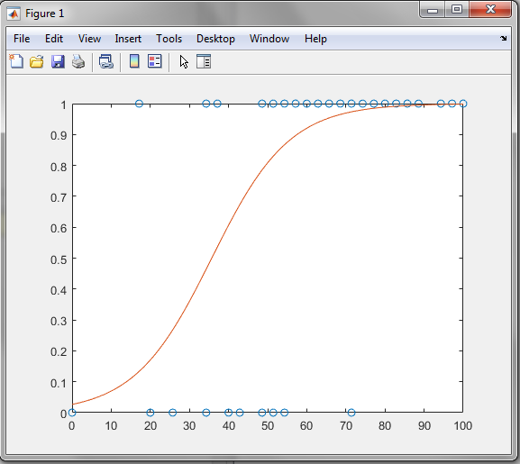

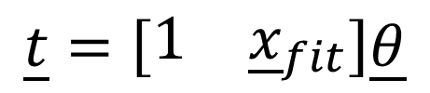
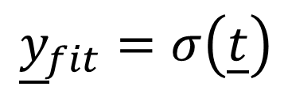
Solving with Matlab
Step 3: displaying the fit
>> sigma=@(t) 1/(1+exp(-t));
>> xfit=linspace(0,100)';
>> t= [xfit.^0 xfit]*B;
>> yfit=arrayfun(sigma,t);
>> plot(x,y,'o',xfit,yfit,'-')
$$σ\left(t\right)=\frac{1}{1+e^{−t}}$$
$$\underline{t}=\left[\begin{matrix}1 & {\underline{x}}_{fit}\end{matrix}\right]\underline{θ}$$
$${\underline{y}}_{fit}=σ\left(\underline{t}\right)$$
Notes:
As a next step let us deiplay the fitted logistic function
First we define the logistic function sigma
You should be familiar by now with this syntax
Then we define a vector xfit containing 100 equally spaced points between 0 and 100
Next we compute the variable t for these points using our fitted parameters B we found with the logistic regression.
Finally we computed the fitted values yfit by applying the sigma function the vector t
We do this using the matlab function arrayfun
The first argument is the function we want to apply to a vector
The second argument is the vector to which we want to apply the function
The vector we want to apply the logistic function to is the vector t
With the plot function we can plot the data set and the fitted logistic function

Slide 18
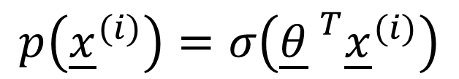
Solving with Matlab
Step 4: using the result of the fit to make predictions
$$p\left({\underline{x}}^{(i)}\right)=σ\left({\underline{θ} }^{T}{\underline{x}}^{(i)}\right)$$
>> sigma(B'*[1; 60])
ans =
0.9205
>> sigma(B'*[1; 25])
ans =
0.2537
Notes:
Now that we trained our model on the data set we can use it to make predictions
As first example let us predict what is the probability to pass the course if you obtained 60/100 in the midterm
For this we compute sigma(B'*[1; 60])
We obtain a probability of 92%. So there is very high chance to pass the course bsed on previous experience
On the other hand if you did 25/100 in the midterm then the model predicts a probability of 25% to pass the course based on previous experience
These were two examples where the predictions are quite clear. Either very high chance to pass or very high chance to fail.
You will not that there is a zone where the predictions are not as clear
For grades around 40 the model will predict probabilities around 50% which means there are similar chances to pass or fail the course
Or course all these are only predictions of probabilities.
As you will note from the data set there are cases where students passed the class despite low midterm grades and cases where students failed the class despite high midterm grades. But these are rather exceptions

Slide 19
Summary
Logistic regression is used to predict probabilities that an instance belongs to a certain class
Logistic regression is based on the logistic function and uses the log-loss cost function to find the optimal model parameters
Matlab has an inbuilt function to preform logistic regression
Notes:
Let us summarize the key findings
Logistic regression is used to predict probabilities that an instance belongs to a certain class
Logistic regression is based on the logistic function and uses the log-loss cost function to find the optimal model parameters
Matlab has an inbuilt function to preform logistic regression

